Slide 1



PHISHING
AWARENESS
TRAINING
Presented by
Revanth Kondabathula

Slide 2


Contents
1
Introduction
2
Understanding Phishing
3
Identifying Phishing Emails
4
Unmasking Phishing Websites
5
Combatting Social Engineering Tactics
6
Proactive Defense Strategies
7
Reporting and Response Protocols
8
Conclusion

Slide 3

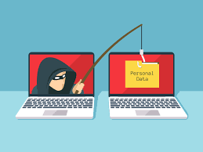


Introduction
In today's digital landscape, understanding and effectively countering phishing threats is paramount to our organization's security and integrity.
1

Slide 4
PHISHING AWARENESS TRAINING
Understanding Phishing
Types of Phishing Attacks
Importance of Awareness
Definition
Phishing represents a nefarious attempt by cybercriminals to lure unsuspecting individuals into divulging sensitive information.
These attacks come in various forms, including email phishing, spear phishing, smishing, and vishing, each leveraging different mediums to exploit vulnerabilities
Recognizing the nuances of phishing is crucial for fortifying our defenses and safeguarding against potential breaches.
2

Slide 5
PHISHING AWARENESS TRAINING
Identifying Phishing Emails
First Line of Defense
Cultivating Vigilance
Diligence is our first line of defense against phishing emails. Scrutinizing sender addresses, language inconsistencies, and unexpected requests can unveil potential threats.
Encourage skepticism among colleagues regarding unsolicited requests or urgent demands for sensitive information, promoting a culture of vigilance within our organization.
3

Slide 6
PHISHING AWARENESS TRAINING
Unmasking Phishing Websites
Vigilance Against Phishing Sites
Deceptive Tactics
Educational Efforts
Phishing websites often masquerade as legitimate entities, employing deceptive tactics to deceive users.
We must remain vigilant, scrutinizing URLs for irregularities, ensuring the presence of SSL/TLS encryption, and employing reputable website verification tools to discern authenticity.
Educating our workforce on the red flags associated with phishing websites is imperative for fostering a cyber-resilient environment.
4

Slide 7

PHISHING AWARENESS TRAINING
Combatting Social Engineering Tactics
The Psychological Weapon
Social engineering serves as a potent weapon in the arsenal of cybercriminals, exploiting human psychology to manipulate individuals into divulging sensitive information.
Promoting Awareness
By heightening awareness and promoting critical thinking, we can inoculate our workforce against the psychological ploys employed by malicious actors.
5

Slide 8
PHISHING AWARENESS TRAINING
Proactive Defense Strategies
Adopting Strategies
Empowerment Tools
Cultivating Resilience
Adopting proactive defense strategies is essential in mitigating the risks posed by phishing attacks.
Regularly updating software, implementing multi-factor authentication, and disseminating educational resources empower our organization to stay one step ahead of potential threats.
Together, we fortify our defenses and cultivate a culture of cybersecurity resilience.
6

Slide 9
PHISHING AWARENESS TRAINING
Reporting and Response Protocols
Establishing Protocols
Encouragement of Reporting
Collaborative Incident Response
Establishing robust reporting and response protocols is paramount in swiftly neutralizing phishing threats.
Encourage prompt reporting of suspected phishing attempts, facilitating timely intervention and mitigation efforts.
By fostering a collaborative approach to incident response, we bolster our collective resilience against evolving cyber threats.
7

Slide 10

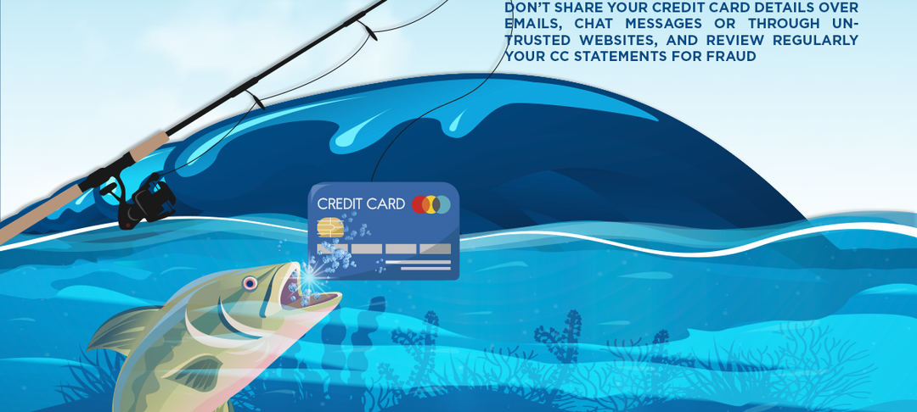
Conclusion
Safeguarding against phishing threats demands a vigilant monitoring, and swift response protocols, to fortify our defenses and uphold the integrity of our digital ecosystem.
8

